Slide 1

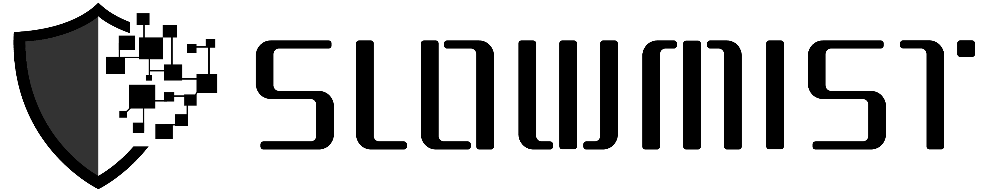
聊聊Web3黑暗森林，用户如何自我保护
Cos/余弦, 2022

Slide 2

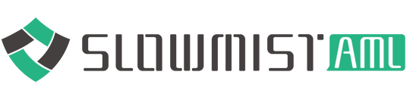
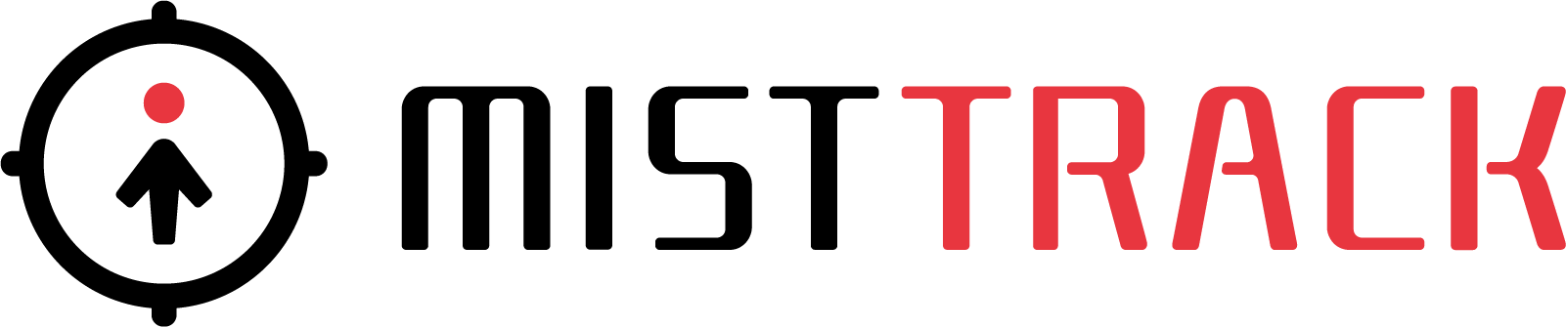
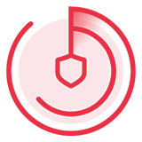

About Us
SlowMist is a blockchain security firm established in January 2018. The firm was started by a team with over ten years of network security experience to become a global force. Our goal is to make the blockchain industry as secure as possible for everyone. We are now a renowned international blockchain security firm that has worked on various well-known projects such as Huobi, Binance, OKX, Crypto.com, imToken, PlatON, 1inch, PancakeSwap, TUSD, Alpaca Finance, Multichain, LayerZero, etc.
SlowMist offers a variety of services that include by are not limited to security audits, threat information, bug bounties, defense deployment, security consultants, and other security-related services. We also offer AML (Anti-money laundering) software, Vulpush (Vulnerability monitoring) , SlowMist Hacked (Crypto hack archives), FireWall.x (Smart contract firewall) , Safe Staking and other SaaS products. We have partnerships with domestic and international firms such as Akamai, BitDefender, FireEye, TianJi Partners, IPIP, etc.
By delivering a comprehensive security solution customized to individual projects, we can identify risks and prevent them from occurring. Our team was able to find and publish several high-risk blockchain security flaws. By doing so, we could spread awareness and raise the security standards in the blockchain industry.

Slide 3
About Me
Founder of SlowMist
Creator of
the DarkHandbook.io(Blockchain Dark Forest Selfguard Handbook)
the ZoomEye.org(cyberspace search engine)
and the XSSOR.io(XSS/CSRF tool)
Author of 《Web前端黑客技术揭秘》
Former vice president of technology and 404 Lab leader from Knownsec

Slide 4
Outline
Background
Know it first:)
Hacked statistics
Some classic cases
Protection Guide
Base
Create Wallet
Backup Wallet
Use Wallet
Q&A

Slide 5
Background
It is a dark forest, Know it first:)

Slide 6
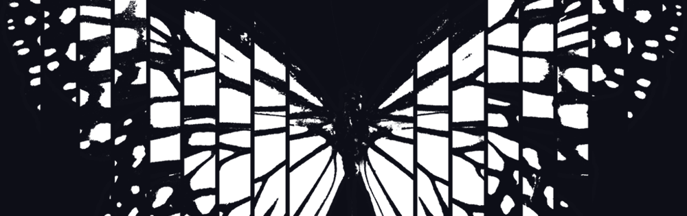

Some agreements
In the blockchain forest, most of the time we are players. I will focus on how to defend from the perspective of player security.
The blockchain I'm talking about here includes Blockchain itself, Cryptocurrency(or Crypto) and Web3, etc.
I try to explain these contents in a non-technical way:)
However, there are so many security issues in the blockchain forest that I can't explain them all one by one. I only show some key points.
Almost all the details related to this PPT can be found here:
https://github.com/slowmist/Blockchain-dark-forest-selfguard-handbook

Slide 7
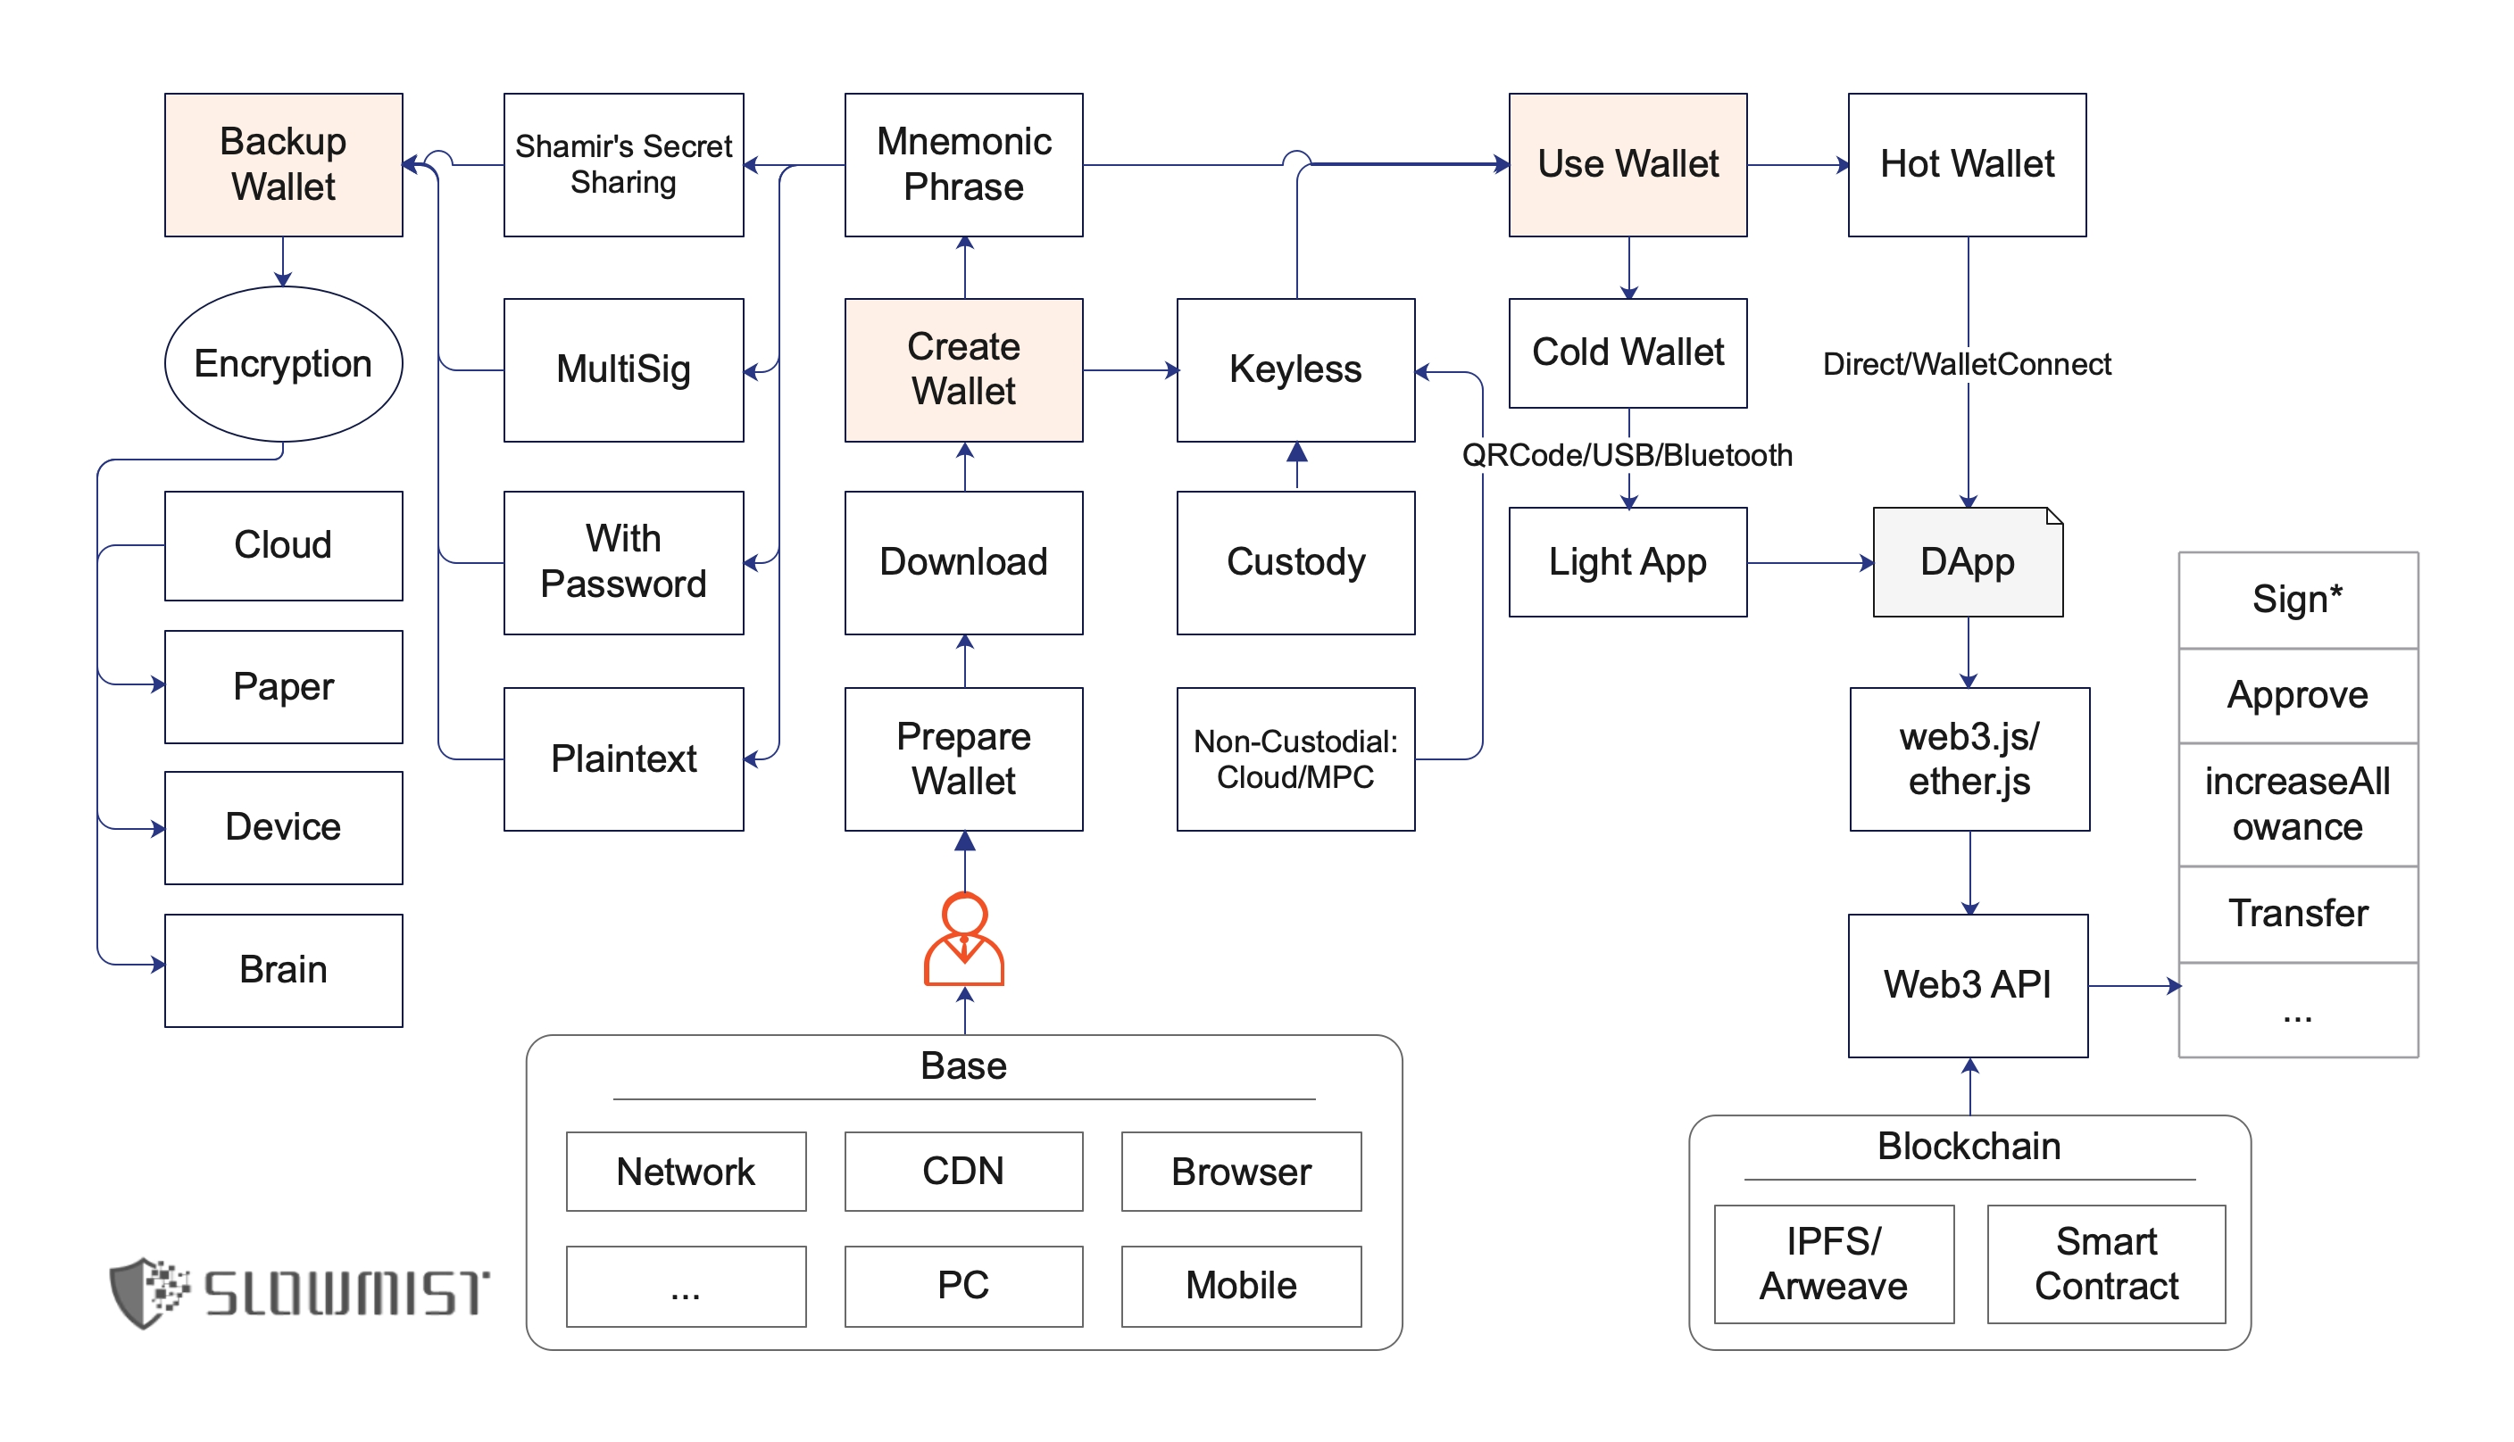
Dive into blockchain forest:)
Take away the assets...

Slide 8
Hacked statistics
Only the publicly disclosed hacked events of blockchain forest are counted, and they are generally related to projects rather than individuals.

Slide 9


Hacked statistics
The total amount of money lost by blockchain hackers is about
$ 27,006,417,838.89
Total hack events 797.
From: https://hacked.slowmist.io/
Statistics as of 2022/8/1

Slide 10
Hacked statistics
Category | Hack event(s) | Amount of loss ($)
Blockchain | 43 | 362,909,918.00
Exchange | 103 | 10,358,962,412.39
Wallet | 27 | 289,619,732.59
ETH Ecosystem | 165 | 3,997,575,744.86
BSC Ecosystem | 98 | 815,582,145.55
Tron Ecosystem | 23 | 11,224,334.36
EOS Ecosystem | 119 | 25,927,302.55
Polygon Ecosystem | 12 | 70,181,808.00
HECO Ecosystem | 3 | 64,533.00
Fantom Ecosystem | 10 | 84,910,991.57
Solana Ecosystem | 9 | 400,054,230.22
Avalanche Ecosystem | 6 | 106,500,000.00
Polkadot Ecosystem | 8 | 9,546,460.00
NFT Ecosystem | 64 | 188,532,440.77
Other | 107 | 10,284,825,785.03
Classification of hacked objects
Attack method TOP 10
TOP | Attack method | Event(s)
1 | Scam | 107
2 | Flash loan attack | 62
3 | Transaction congestion attack | 27
4 | Roll back attack | 26
5 | Contract vulnerabilities | 26
6 | 51% attack | 24
7 | Random number attack | 23
8 | Stolen hot wallet | 21
9 | Phishing attack | 20
10 | Discord server hacked | 19

Slide 11
Some classic cases
There are two kinds of security events: one is the security event of the project itself used by the user, and the other is the security event of the user himself.

Slide 12
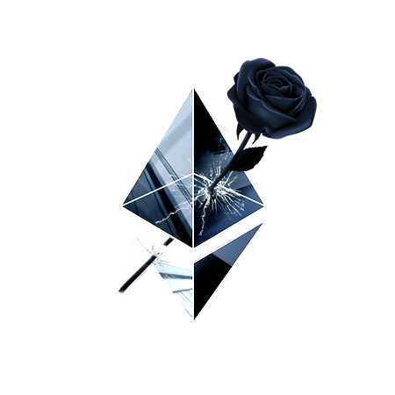
ETH Black Valentine's Day
Billions of Tokens Theft Case cause by ETH Ecological Defects.
2016/02/14 03:59:14 PM The first time IN, this day is Valentine's Day.
The hacker used the authentication flaw of Ethereum node's Geth/Parity RPC API to maliciously steal tokens via eth_sendTransaction.
More: https://mooz.space/eth214/

Slide 13
False top-up
It happened in the top-up(deposit) process of a cryptocurrency exchange/wallet.
If there is wrong judgment of top-up process, the false top-up maybe happen.
Different blockchains have different transfer characteristics or technical details, which leads to different implementations of judging whether the top-up is successful on different blockchains.
We have disclosed many fake top-up attacks in the first round, e.g.,
USDT, EOS, XRP, ETH Token, Bitcoin RBF, XMR, ETH, IOST, Filecoin, NEM, Solana, TRX, Terra, Dogecoin, Litcoin, etc.
More: https://github.com/slowmist/Knowledge-Base#fire-false-top-up

Slide 14
Ransomware
Pay in Bitcoin:
WannaCry
GandCrab
...

Slide 15
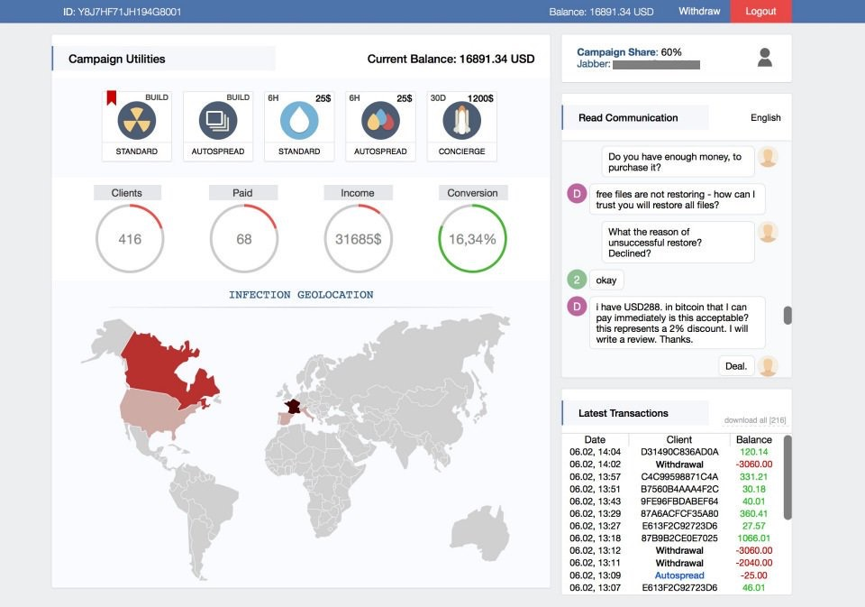
Ransomware as a service(RaaS)
High benefits
High efficiency
High anonymity

Slide 16
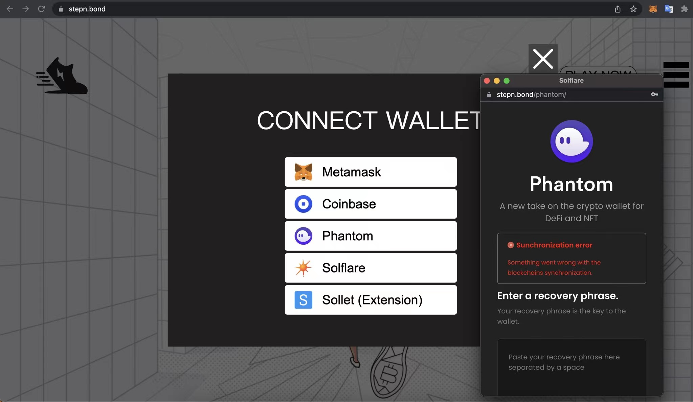
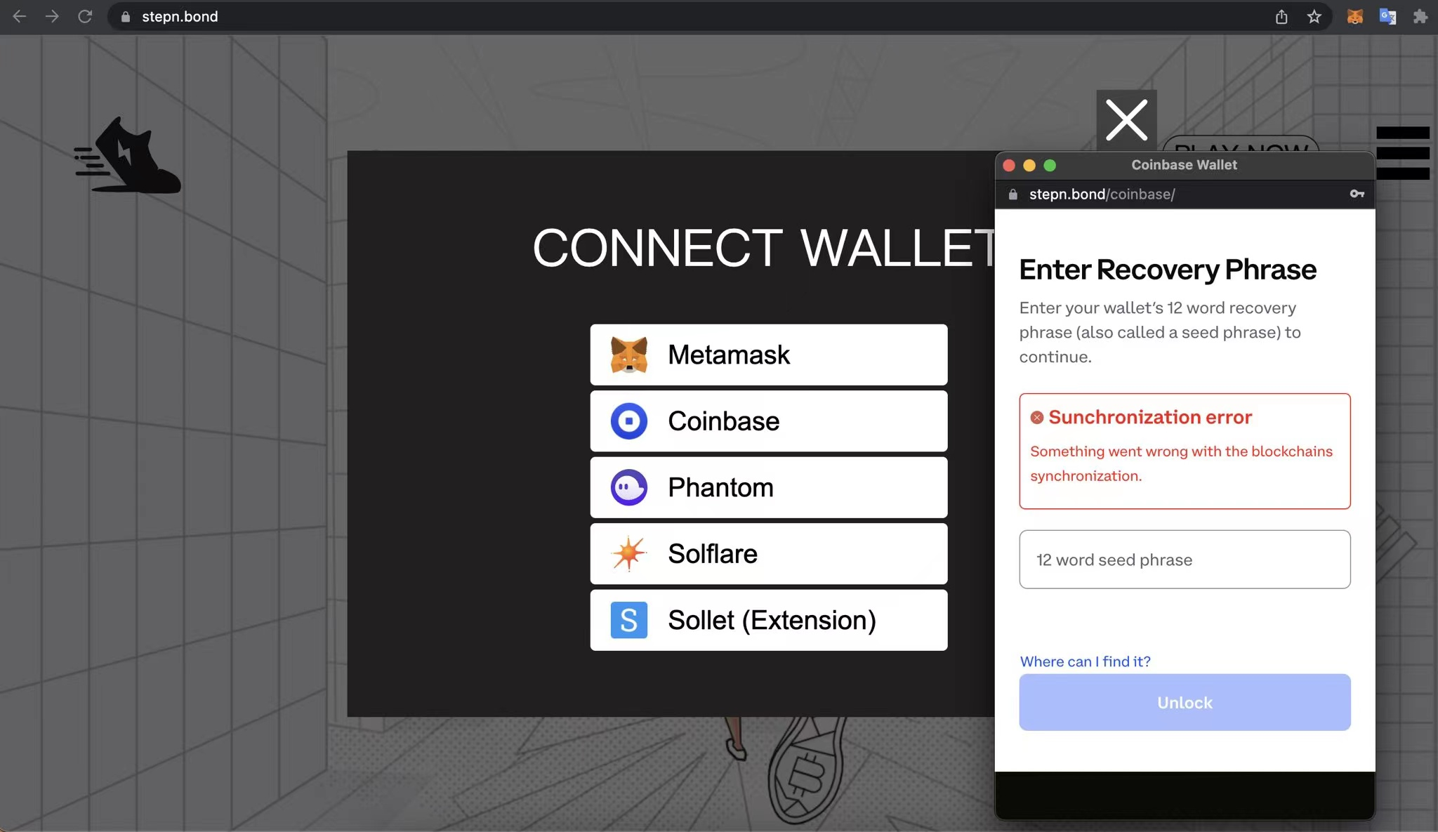
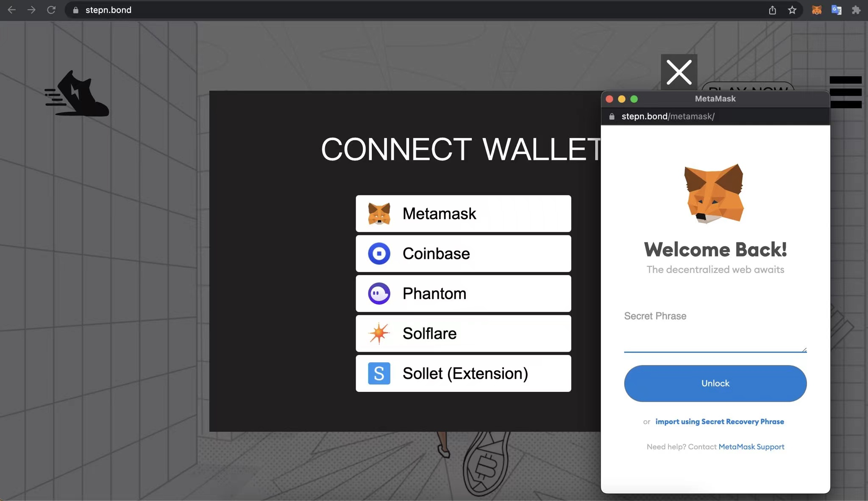
Crypto Phishing 1
Phishing websites stolen Mnemonic Phrase.

Slide 17
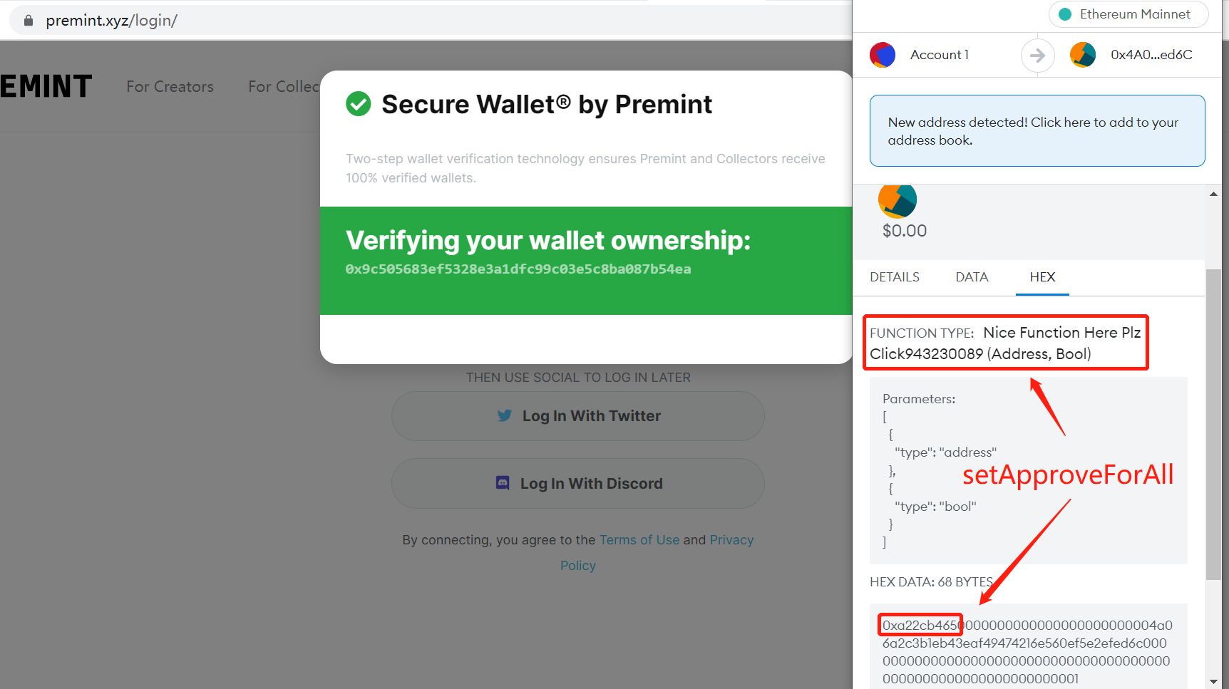
Crypto Phishing 2
Approve is a common mechanism of Ethereum smart contracts(e.g., of ERC20, ERC721, ERC1155, etc).
Phishing websites can use Approve to do the tokens theft attack.

Slide 18
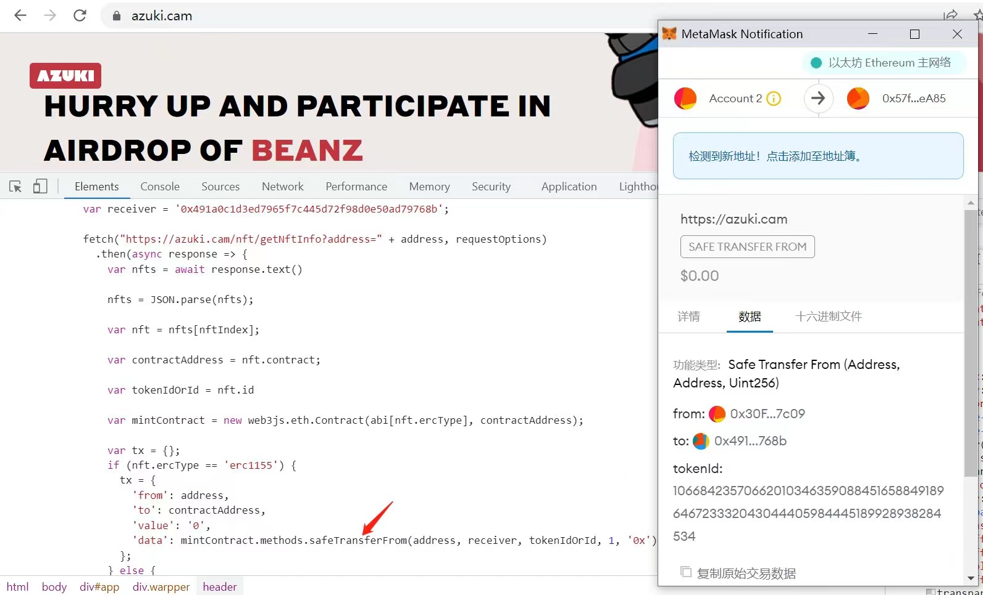
Crypto Phishing 3
Phishing websites can use Transfer to do the ETH/tokens theft attack.

Slide 19
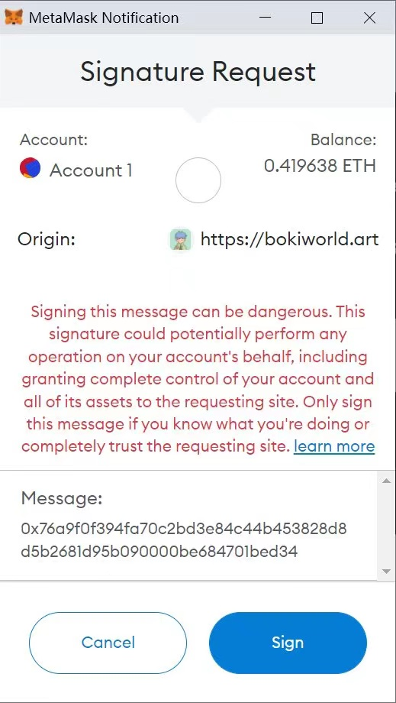
Crypto Phishing 4
Phishing websites can use eth_sign to do the ETH/tokens theft attack.
eth_sign is a low-level signature method of Ethereum, and MetaMask will have a red text alert.
For the user, the message is just a string of 66 characters beginning with 0x.
This is a kind of blind sign.
解析：https://mp.weixin.qq.com/s/E-LSN5eYwWhCQOH46-XyNg

Slide 20
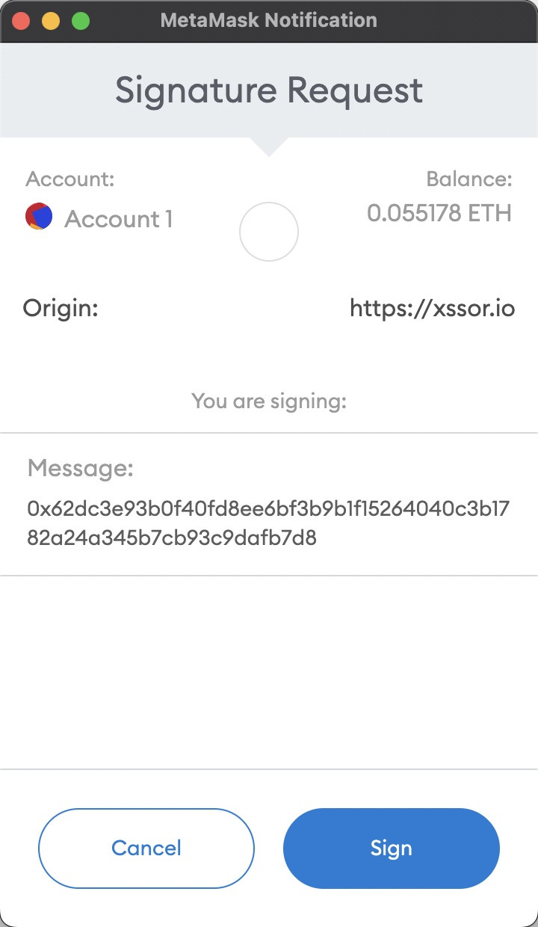
Crypto Phishing 5
Phishing websites can use personal_sign to do the NFTs theft attack.
The root causes are:
Users signed NFT listing requests on NFT Marketplace.
Hackers phished to obtain relevant signatures from users.
Hackers stole the NFTs of users at very low cost.

Slide 21
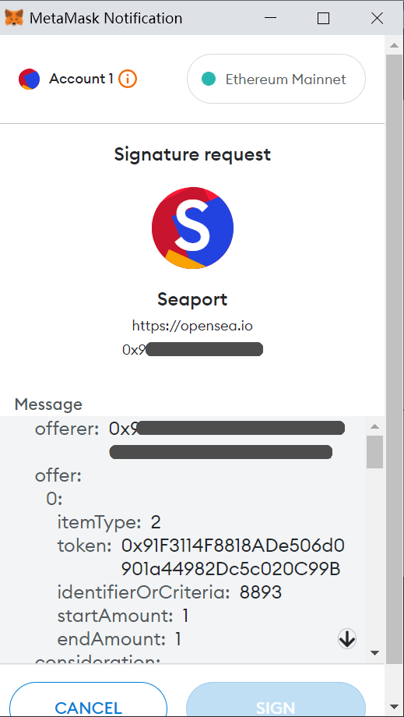
Crypto Phishing 6
Phishing websites can use signTypedData_v4 to do the NFTs theft attack.
The root causes are:
Users signed NFT listing requests on NFT Marketplace.
Hackers phished to obtain relevant signatures from users.
Hackers stole the NFTs of users at very low cost.
解析：https://twitter.com/evilcos/status/1578993566675742721

Slide 22
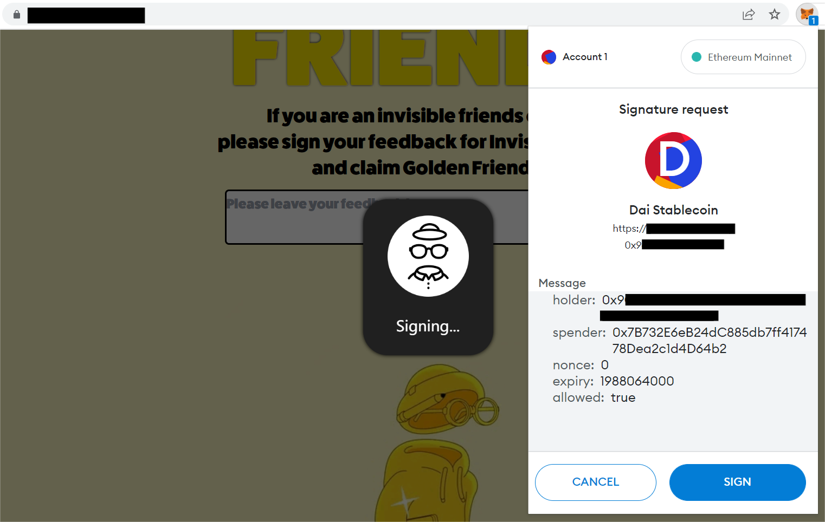
Crypto Phishing 7
Signature phishing against DAI/USDC
If signed, the hacker can obtain the signature result (r, s, v values)...

Slide 23
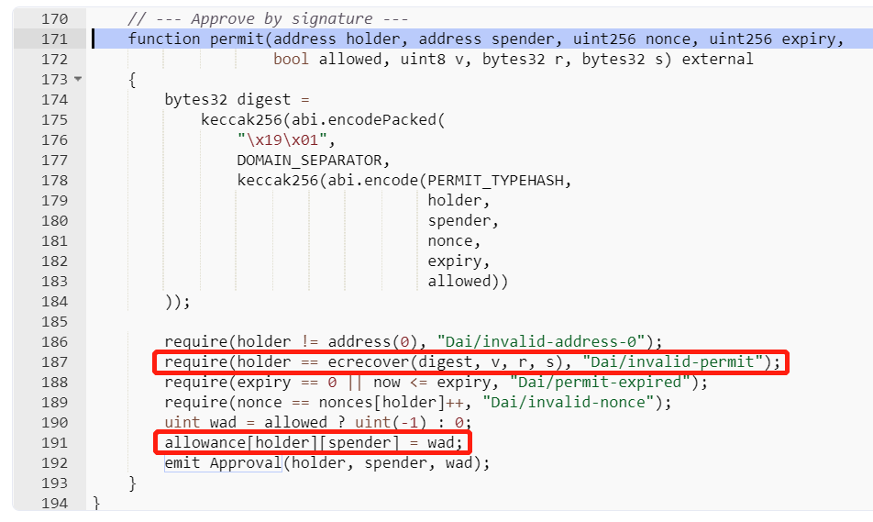
Crypto Phishing 7
Call the DAI's permit function to complete authorization and coin theft:

Slide 24
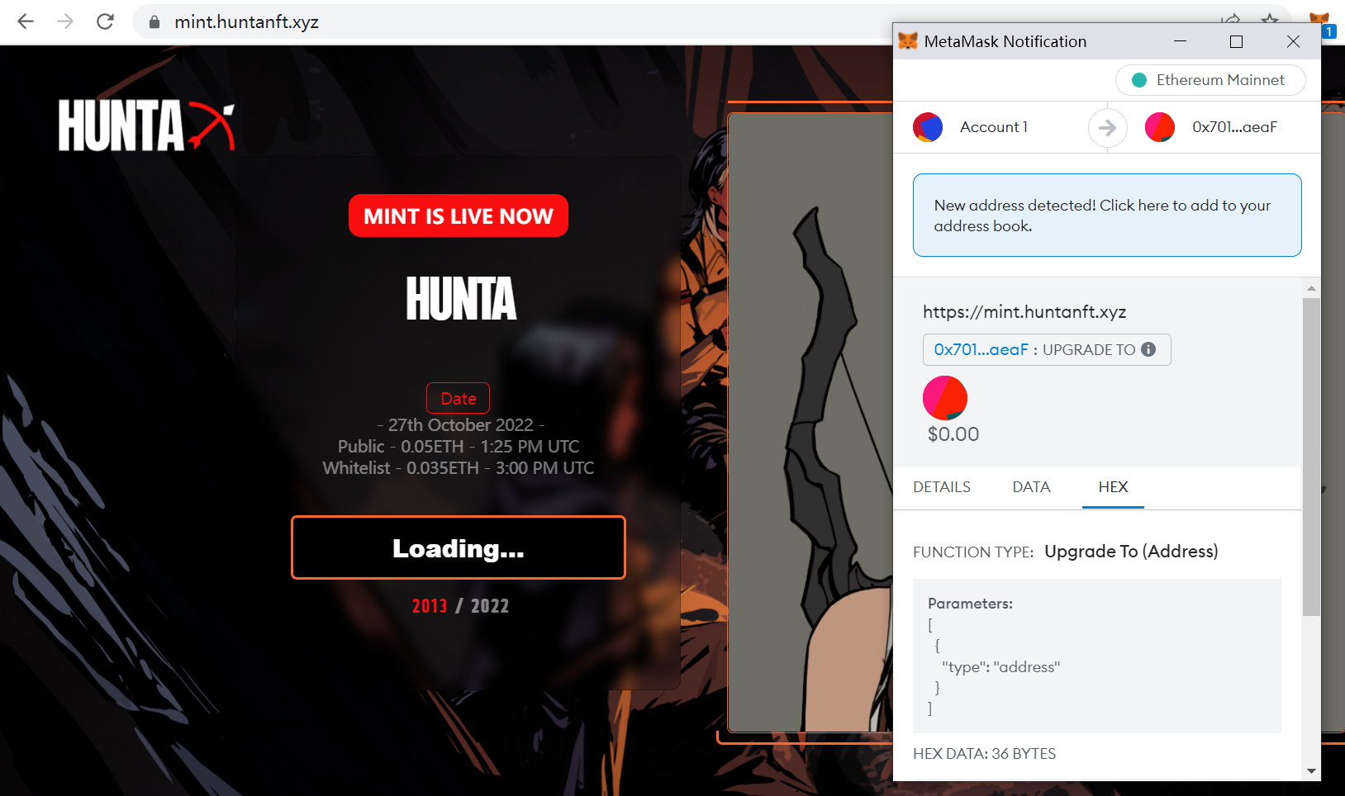
Crypto Phishing 8
Phishing interacting with upgradeTo of OwnableDelegateProxy of OpenSea Wyvern Protocol:-(

Slide 25
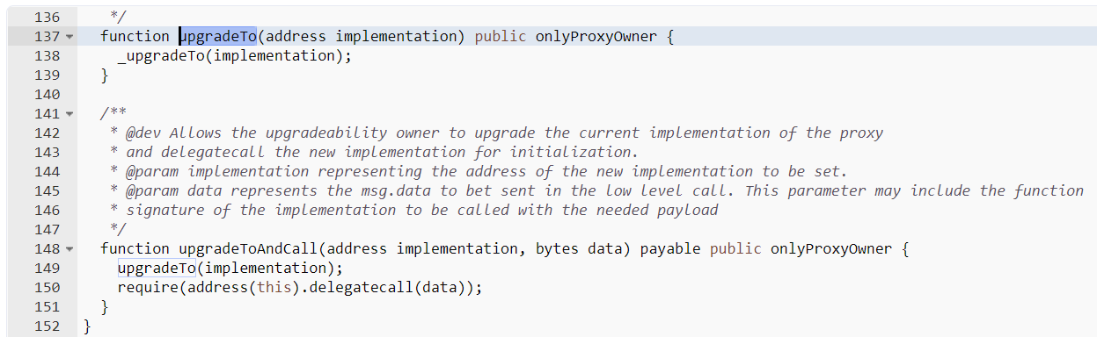
Crypto Phishing 8
Phishing interacting with upgradeTo of OwnableDelegateProxy of OpenSea Wyvern Protocol:-(
Set a malicious implementation address.
Which gives the hacker permission to withdraw your NFTs.

Slide 26
Protection Guide
From Base -> Create Wallet -> Backup Wallet -> Use Wallet.

Slide 27
Risks of Each Key Step

Slide 28
Risks of [Base]
If the cornerstones are not secure, the privacy of the cornerstones are meaningless, then the superstructure will be as fragile as a building in the air.

Slide 29
Risks of [Base]: Operation System
Windows 10(and higher) and macOS are both secure options.
If you have the ability, you can choose Linux, such as Ubuntu, or even extremely security & privacy focused ones like Tails, or Whonix.
Pay close attention to system updates, and apply them asap when available.
The capability to master the Operating System comes next.
Choice a good antivirus software, like Kaspersky, BitDefender, AVG.
That disk encryption should be turned on for important computers.
https://docs.microsoft.com/en-us/windows/security/encryption-data-protection
https://support.apple.com/en-us/HT204837
https://veracrypt.fr/
Don't forget about download security.

Slide 30
Risks of [Base]: Mobile phone
Do not jailbreak/root your phone, it‘s unnecessary unless you are doing relevant security research. If you are doing it for pirated software it really depends on how well you can master the skill.
Don't download apps from unofficial app stores.
Don't do it unless you know what you are doing. Not to mention there are even many fake apps in official app stores.
The prerequisite of utilising the official Cloud synchronization function, is that you have to make sure your account is secure, otherwise if the Cloud account gets compromised, so will the mobile phone.

Slide 31
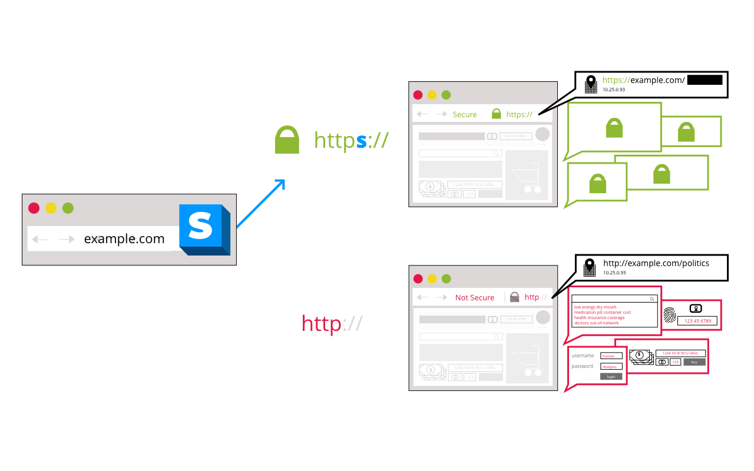
Risks of [Base]: Network
Don't connect to unfamiliar Wi-Fi networks unless the more popular & secure 4G/5G network is not available or not stable.
HTTPS Everywhere:)
https://www.eff.org/https-everywhere

Slide 32
Risks of [Base]: Browsers
The most popular browsers are Chrome and Firefox, in crypto fields some will use Brave too.
Update as quickly as possible, don't take chances.
Don't use an extension if not necessary. If you do, make your decisions based on user's reviews, number of users, maintaining company, etc, and pay attention to the permission it asks for. Make sure you get the extension from your browser's official app store.
Multiple browsers can be used in parallel, and it is strongly recommended that you perform important operations in one browser, and use another browser for more routine, less important operations.
Here are some well-known privacy focused extensions (e.g., uBlock Origin, HTTPS Everywhere, ClearURLs, etc.), feel free to try them out.

Slide 33
Risks of [Base]: Password Manager
Use a well-known one like 1Password, Bitwarden, etc.
Do not ever forget your master password, and keep your account information safe, otherwise everything will be lost.
Make sure your email is secure. If your email is compromised, it might not directly compromise the sensitive information in your password manager, but bad actors have the capability to destroy it.
I have verified the security of the tools I mentioned (e.g., 1Password), and have been closely watching the relevant security incidents, user reviews, news, etc.. But I cannot guarantee that these tools are absolutely secure, and no black swan events are ever gonna happen in the future to them.

Slide 34
Risks of [Base]: 2FA
Google Authenticator, Microsoft Authenticator, etc.
If you use a password manager (e.g., 1Password), it also comes with a 2FA module, which is very handy.
Always remember to make backups, because losing 2FA can be a hassle.

Slide 35
Risks of [Base]: Email
You should choose from tech giants, e.g., Gmail, Outlook, or QQ Email.
You have to be careful about Email phishing attacks.
You don't need to deal with every single Email, especially the embedded links and attachments, where Trojans may be hidden.
Two well-known privacy-friendly email services: ProtonMail and Tutanota.
My suggestion is to separate these private-friendly mailbox from daily usage, and only use them for services that requires special attention to privacy.
You also need to regularly use your free Email services to prevent yout accounts from being suspended due to long time inactivity.

Slide 36
Risks of [Base]: SIM Card
SIM card and mobile phone number are also very important basic identities in many cases, just like email.
Enable the SIM card password (PIN code), so every time when I turn on my phone or use my SIM card in a new device, I need to enter the correct password.
Don't forget this password, otherwise it will be very troublesome.
SIM Port Attack (SIM card transfer attack):
https://medium.com/coinmonks/the-most-expensive-lesson-of-my-life-details-of-sim-port-hack-35de11517124

Slide 37
Risks of [Base]: GPG
PGP, short for Pretty Good Privacy, is a 30-year-old commercial encryption software now under the umbrella of Symantec.
OpenPGP is an encryption standard derived from PGP.
GPG, the full name is GnuPG, is an open source encryption software based on the OpenPGP standard.
In security encryption, don't try to reinvent the wheel; GPG, if used in a correct way, can improve security level significantly!
GPG Suite https://gpgtools.org/
Gpg4win https://www.gpg4win.org/

Slide 38
Risks of [Base]: Segregation
The core value behind the security principle of segregation, is the zero trust mindset.
If your password security practice is good, when one of your accounts gets hacked, the same password will not compromise other accounts.
If your cryptocurrency is not stored under one set of mnemonic phrase, you will not lose everything if you ever step into a trap.
If your computer is infected, luckily this is just a computer used for casual activities, and there is nothing important in there. So you do not have to panic, as reinstalling the computer would solve most of the problems. If you are good at using virtual machines, things are even better, as you can just restore the snapshot. Good virtual machine tools are: VMware, Parallels.
To summarize, you can have at least two accounts, two tools, two devices, etc. It is not impossible to completely create an independent virtual identity after you are familiar with it.

Slide 39
Risks of [Create Wallet]
The core of the wallet is the Private Key (or Mnemonic Phrase).

Slide 40
Risks of [Download]
Many people cannot find the real official website, or the right application market, and eventually install a fake wallet.
Many people do not know how to identify whether the downloaded application has been tampered or not.
To solve the first problem above:
using Google
using well-known official websites, e.g., CoinMarketCap
asking trusted people and friends
You can cross-reference the information obtained from these different sources, and ultimately there is only one truth:)

Slide 41
Risks of [Download] PC Wallet
Hash checks: e.g., MD5, SHA256, etc. MD5 works for most cases, but there is still a tiny risk of hash collision, so we generally choose SHA256, which is safe enough.
GPG signature verification: this method is also very popular. It is highly recommended to master GPG tools, commands, and methods. Although this method is a bit difficult for newcomers, you will find it very useful once you get familiar with it. two GPG tools:
GPG Suite, for MacOS.
Gpg4win, for Windows.
More: https://sparrowwallet.com/download/

Slide 42
Risks of [Download] Browser Extension Wallet
You have to pay attention to is the download number and rating in the Chrome web store.
MetaMask, for example, has more than 10 million downloads and more than 2,000 ratings (though the overall rating is not high).
And double check from the real official website of MetaMask:)

Slide 43
Risks of [Download] Mobile Wallet
It is similar to the browser extension wallet.
Follow the real official website to download the right App.

Slide 44
Risks of [Download] Hardware Wallet
Buy it from the official website.
Do not buy them from other online stores.
Pay attention to whether the wallet is intact.
Create the mnemonic phrase and wallet address at least three times from scratch. And make sure that they are not repeated.

Slide 45
Risks of [Mnemonic Phrase]
It is common to see 12/15/18/21/24 words.
https://github.com/bitcoin/bips/blob/master/bip-0039/bip-0039-wordlists.md
At present, 12-word is popular and secure enough.
Whether need online?
Try many times to see if the generated seeds are random.
Environment is safe(no others or cameras behind of you).

Slide 46
Risks of [Backup Wallet]
The core of the wallet is the Private Key (or Mnemonic Phrase).

Slide 47
Kinds of [Mnemonic Phrase]
Plain Text
With Password
Multi-signature
Gnosis Safe
MPC(Secure Multi-Party Computation): ZenGo, Safeheron, Fireblocks
Shamir's Secret Sharing, or SSS for short
https://support.keyst.one/advanced-features/recovery-phrase/import-or-create-shamir-backup
https://wiki.trezor.io/Shamir_backup
Private key looks like:
0xa164d4767469de4faf09793ceea07d5a2f5d3cef7f6a9658916c581829ff5584
Mnemonic phrase looks like:
cruel weekend spike point innocent dizzy alien use evoke shed adjust wrong

Slide 48
Risks of [Backup Wallet]
When backing up wallets, we need assume that any step could be hacked.
Keep in mind that there is no one other than yourself who can be fully trusted.
Sometimes you can't even trust yourself, because your memories may fade away or misplaced.
Avoid a single point of risk. There must be a disaster recovery person and there must be multiple backups.
Some basic forms of backup locations: Cloud, Paper, Device, Brain.
Use encryption, e.g., ZIP, GPG:)

Slide 49
Risks of [Use Wallet]
Once you have created and backed up your wallets, it comes to the real challenge.

Slide 50
Risks of [Cold Wallet]
QRCode, USB, Bluetooth
The target address of the coin transfer was not checked carefully.
Tokens are approved to unknown addresses.
Some signatures that seem not important actually have huge traps in the back.
The cold wallet may not have provided enough necessary information, causing you to be careless and misjudged.
The user interaction security mechanism of "What you see is what you sign" is missing.
The user, lack of relevant background knowledge.

Slide 51
Risks of [Hot Wallet]
Compared to a cold wallet, a hot wallet has basically all the risks that a cold wallet would have.
There is one more: the risk of theft of the mnemonic phrase (or private key).
My biggest concern is: how does each iteration of a well-known wallet ensure that no malicious code or backdoor is planted?
Copay https://blog.npmjs.org/post/180565383195/details-about-the-event-stream-incident

Slide 52
What is DeFi Security
Not only the Smart Contract:)
DeFi security includes at least the following components:
Smart Contract Security
Blockchain Foundation Security
Frontend Security
Communication Security
Human Security
Financial Security
Compliance Security

Slide 53
NFT Security
All the previously mentioned contents on DeFi security can be applied to NFT security.
and NFT itself has a few very specific and unique security topics, for example:
Metadata security
Signature security

Slide 54
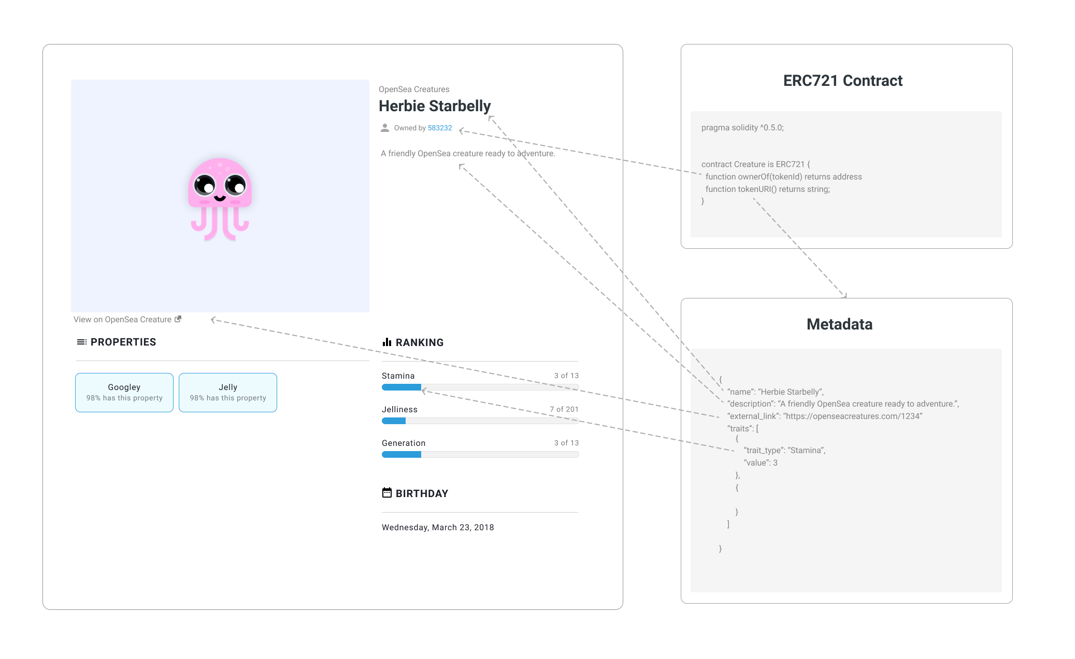
Metadata security
From: https://docs.opensea.io/docs/metadata-standards

Slide 55
Signature security
Phishing websites can use personal_sign to do the NFTs theft attack.
The root causes are:
Users signed NFT listing requests on NFT Marketplace.
Hackers phished to obtain relevant signatures from users.
Hackers stole the NFTs of users at very low cost.
Users can solve such attacks at the source by cancelling the approval:
https://etherscan.io/tokenapprovalchecker
https://revoke.cash/
https://rabby.io/

Slide 56
Security rules and principles
The security rules and principles mentioned here are summarized as follows.

Slide 57
Two major security rules
Zero trust. To make it simple, stay skeptical, and always stay so.
Continuous validation. In order to trust something, you have to validate what you doubt, and make validating a habit.

Slide 58
Security principles
For all the knowledge from the Internet, refer to at least two sources, corroborate each other, and always stay skeptical.
Segregate. Don't put all the eggs in one basket.
For wallets with important assets, don't do unnecessary updates.
What you see is what you sign. You need to be aware of what you are signing, and of the expected result after the signed transaction is sent out. Don't do things that will make you regret afterwards.
Pay attention to system security updates. Apply them as soon as they are available.
Don't download & install programs recklessly can actually prevent most risks.

Slide 59

Q&A
Human is always at the highest and eternal risk. There's a quote from The Three-Body Problem: "Weakness and ignorance are not barriers to survival, but arrogance is."

Slide 60



https://slowmist.com
team@slowmist.com

